Slide 1


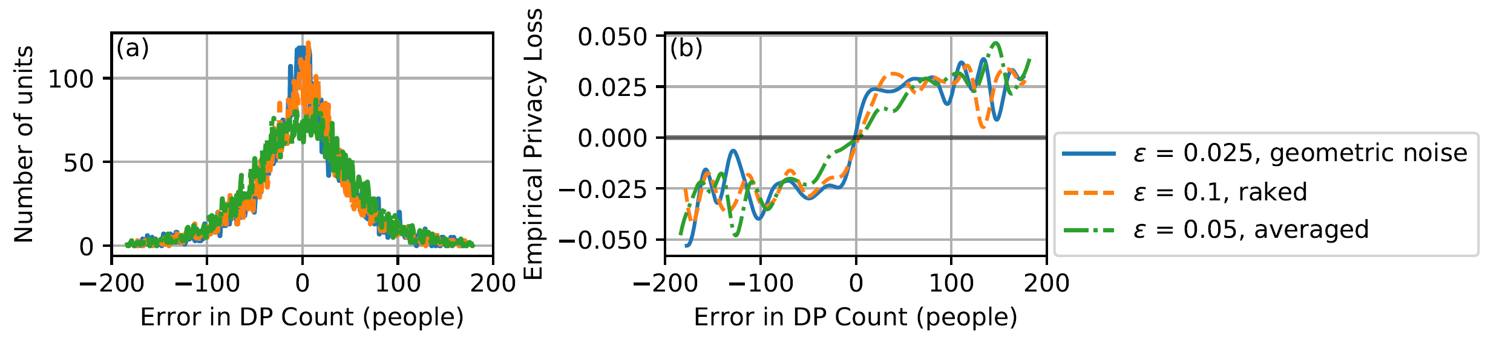
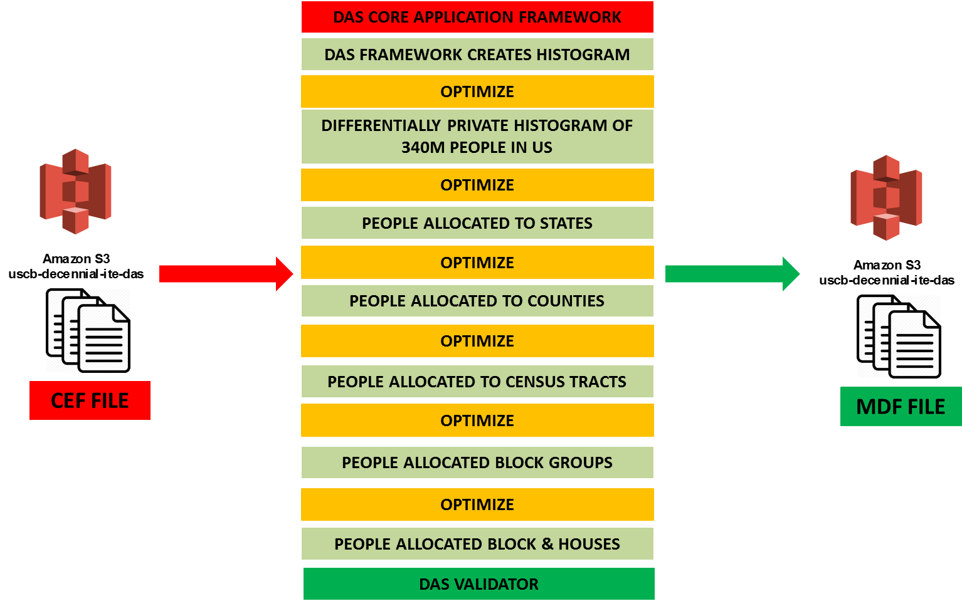
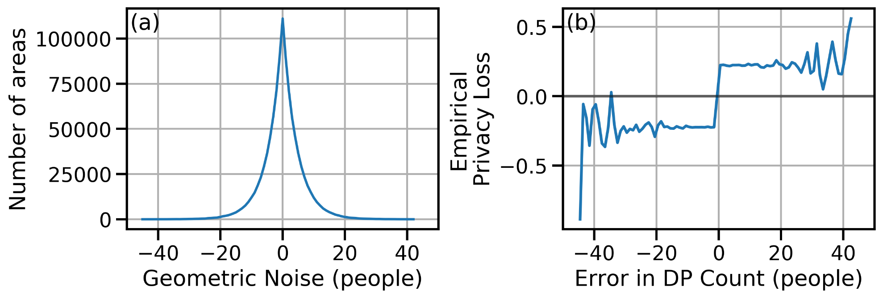
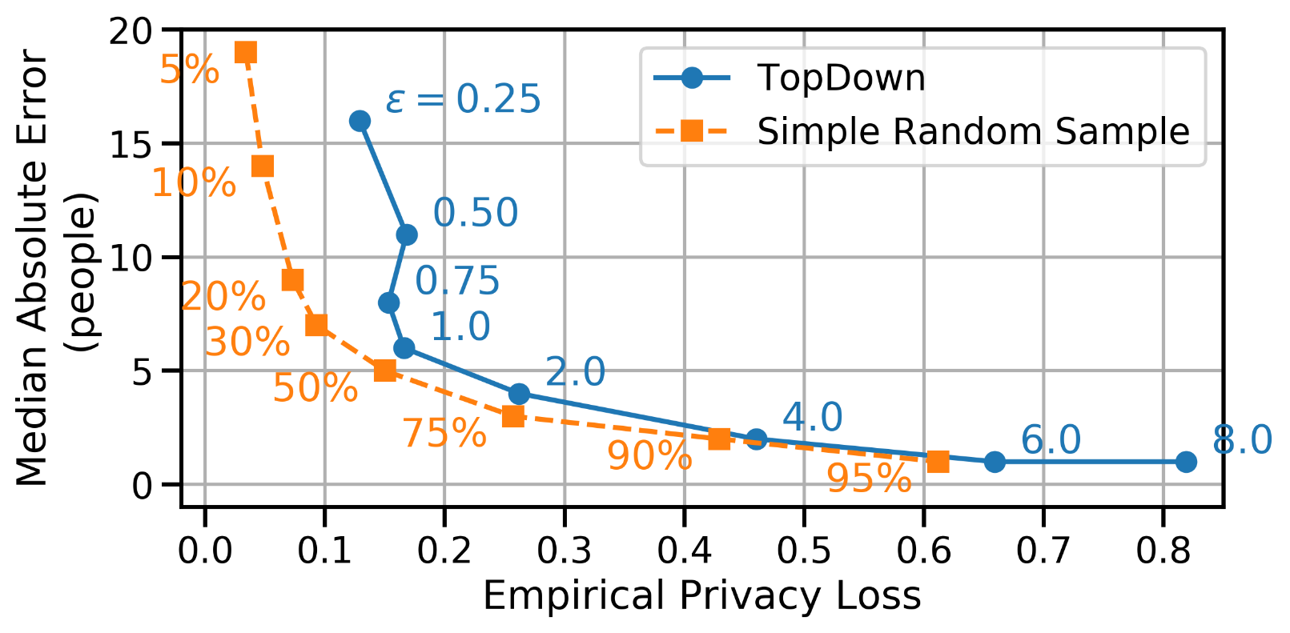
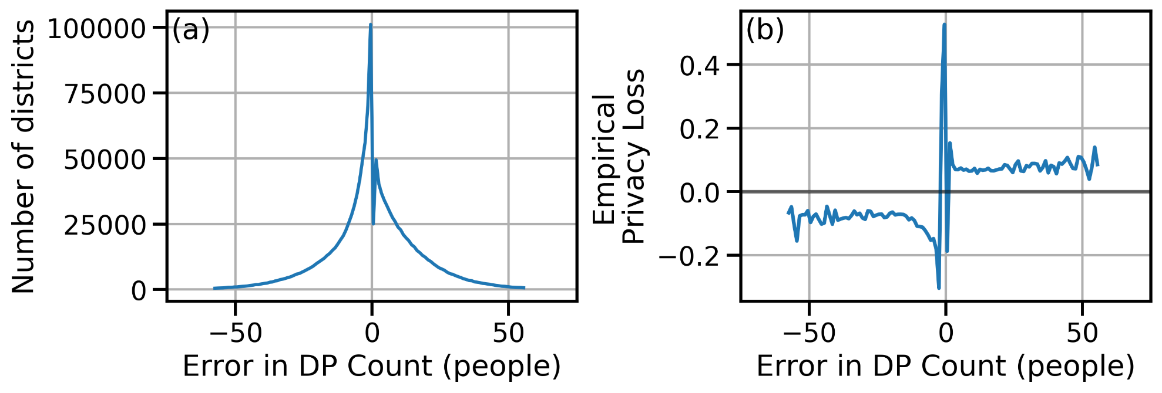
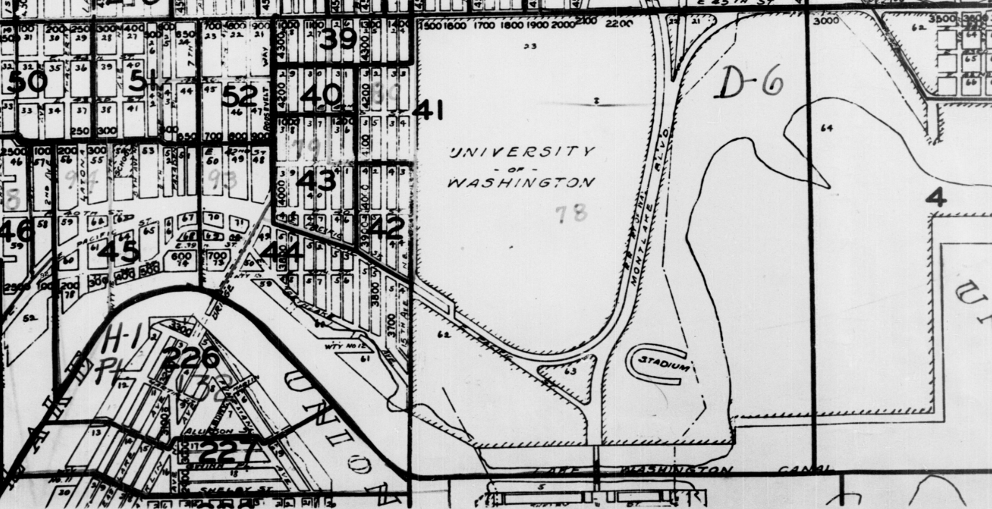
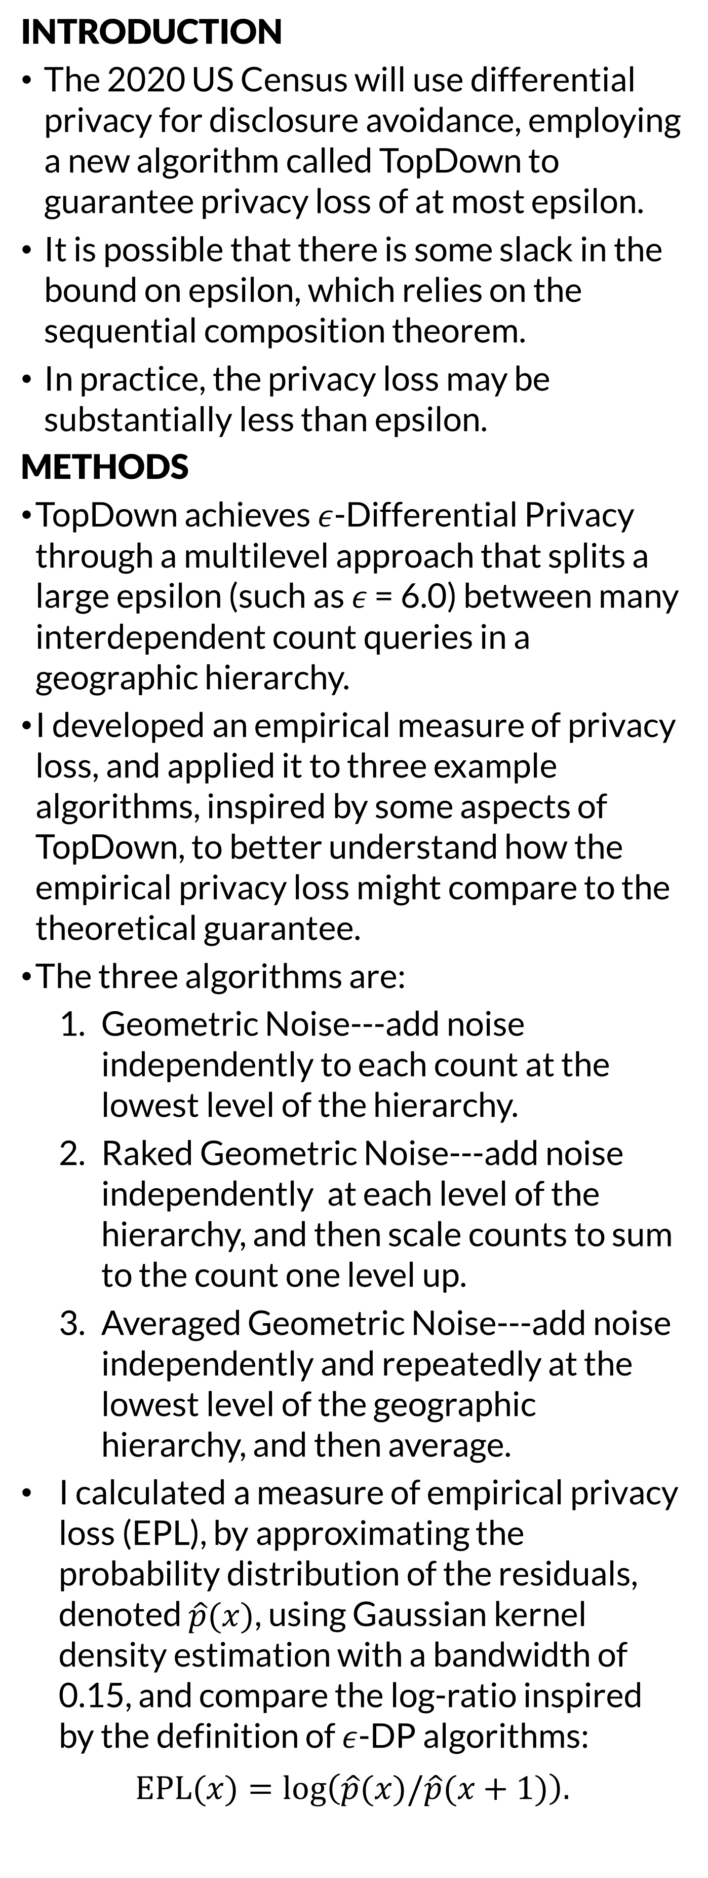
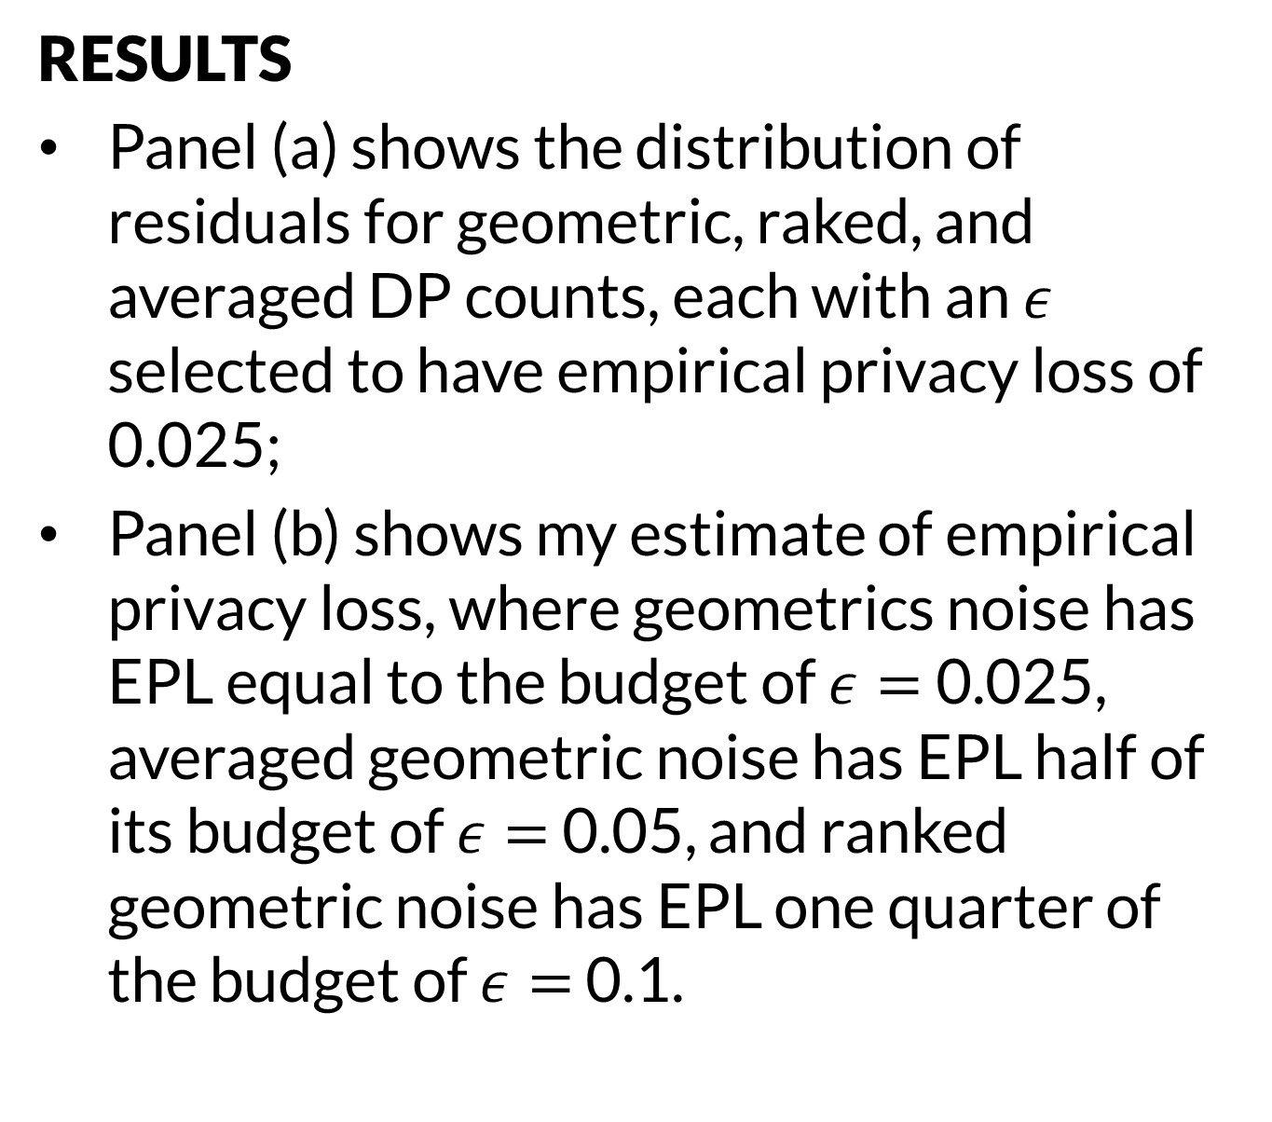
Empirical privacy loss of DP methods like the TopDown may be substantially smaller than proven, due to slack in the Sequential Composition Theorem.
Non-Cognitive Predictors of Student Success: A Predictive Validity Comparison Between Domestic and International Students
Empirical quantification of privacy loss with examples relevant to the 2020 US Census: an experimental investigation of the gap between privacy loss bounds in theory and practice
Abraham D. Flaxman
INTRODUCTION
The 2020 US Census will use differential privacy for disclosure avoidance, employing a new algorithm called TopDown to guarantee privacy loss of at most epsilon.
It is possible that there is some slack in the bound on epsilon, which relies on the sequential composition theorem.
In practice, the privacy loss may be substantially less than epsilon.
METHODS
TopDown achieves $ε$-Differential Privacy through a multilevel approach that splits a large epsilon (such as $ε$ = 6.0) between many interdependent count queries in a geographic hierarchy.
I developed an empirical measure of privacy loss, and applied it to three example algorithms, inspired by some aspects of TopDown, to better understand how the empirical privacy loss might compare to the theoretical guarantee.
The three algorithms are:
Geometric Noise---add noise independently to each count at the lowest level of the hierarchy.
Raked Geometric Noise---add noise independently at each level of the hierarchy, and then scale counts to sum to the count one level up.
Averaged Geometric Noise---add noise independently and repeatedly at the lowest level of the geographic hierarchy, and then average.
I calculated a measure of empirical privacy loss (EPL), by approximating the probability distribution of the residuals, denoted $\hat{p}(x)$, using Gaussian kernel density estimation with a bandwidth of 0.15, and compare the log-ratio inspired by the definition of $ε$-DP algorithms:
$$EPL(x)=log\left(\hat{p}(x)/\hat{p}(x+1)\right).$$
Non-Cognitive Predictors of Student Success: A Predictive Validity Comparison Between Domestic and International Students
RESULTS
Panel (a) shows the distribution of residuals for geometric, raked, and averaged DP counts, each with an $ε$ selected to have empirical privacy loss of 0.025;
Panel (b) shows my estimate of empirical privacy loss, where geometrics noise has EPL equal to the budget of $ε=$0.025, averaged geometric noise has EPL half of its budget of $ε=$ 0.05, and ranked geometric noise has EPL one quarter of the budget of $ε=$ 0.1.

